Slide 1
Optimization
李宏毅
Hung-yi Lee
Notes:
Observation
Hessian
Guess
Linear
Non-linear
Not done:
Global optimality

Slide 2

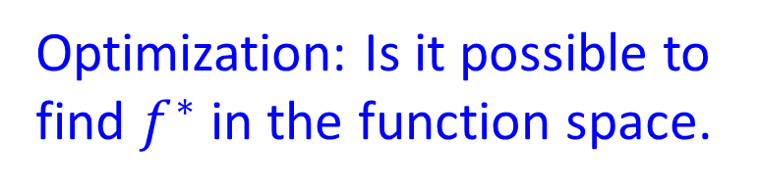


Last time …
Optimization: Is it possible to find $f^{∗}$ in the function space.
3
What is the difference?
small
median
large
2
Deep
$$f^{∗}$$
Small?
1
Shallow
A target function $f^{∗}$ to fit
Eventually cover$f^{∗}$?

Slide 3




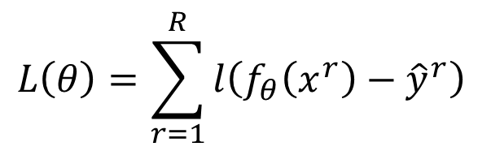


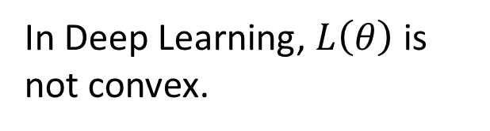
Optimization
Optimization $≠$ Learning
$$L\left(θ\right)=\sum_{r=1}^{R}{l\left(f_{θ}\left(x^{r}\right)−{\hat{y}}^{r}\right)}$$
Network: $f_{θ}\left(x\right)$
Training data:
$$\left(x^{1},{\hat{y}}^{1}\right)$$
$$θ^{∗}=arg\min_{θ}{L\left(θ\right)}$$
$$\left(x^{2},{\hat{y}}^{2}\right)$$
In Deep Learning, $L\left(θ\right)$ is not convex.
.....
$$\left(x^{R},{\hat{y}}^{R}\right)$$
Non-convex optimization is NP-hard.
Why can we solve the problem by gradient descent?

Slide 4
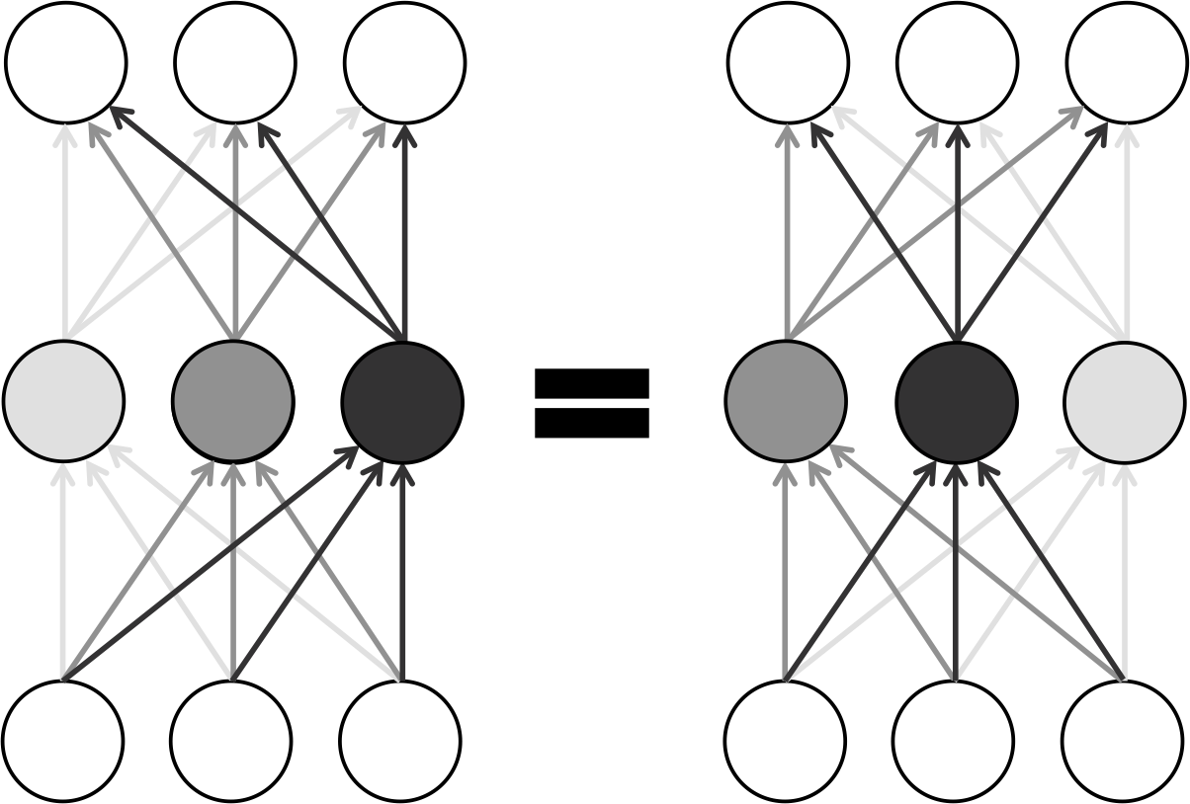
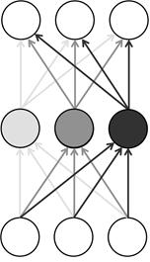
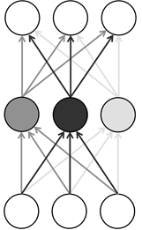
Loss of Deep Learning is not convex
There are at least exponentially many global minima for a neural net.
Permutating the neurons in one layer does not change the loss.
?

Slide 5




Non-convex $≠$ Difficult
$$L\left(θ\right)$$
$$L\left(θ\right)$$
$$L\left(θ\right)$$
Not guarantee to find optimal solution by gradient descent

Slide 6
Outline
Review: Hessian
Deep Linear Model
Deep Non-linear Model
Conjecture about Deep Learning
Empirical Observation about Error Surface

Slide 7
Hessian Matrix:
When Gradient is Zero
Some examples in this part are from: https://www.math.upenn.edu/~kazdan/312F12/Notes/max-min-notesJan09/max-min.pdf
Notes:
Read this: http://emp.byui.edu/brownd/mathematics/calculus-rn-rm/hessian-etc.pdf

Slide 8
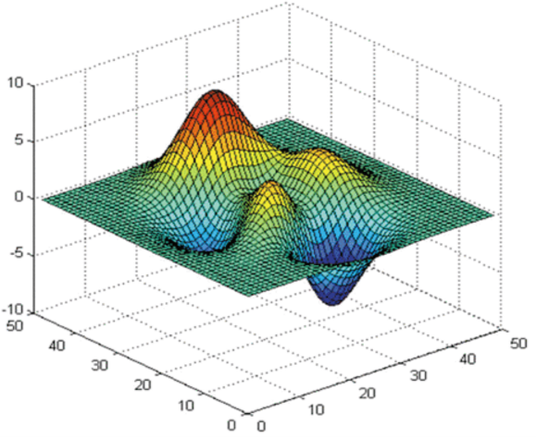
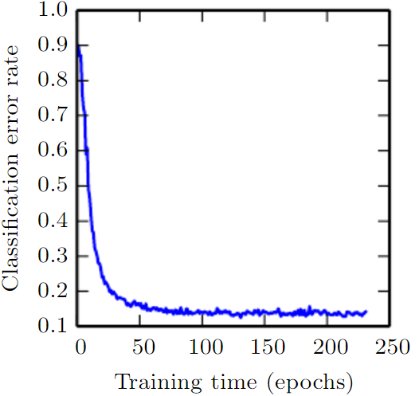
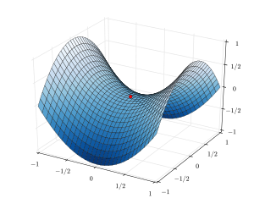
Training stops ….
http://www.deeplearningbook.org/contents/optimization.html
critical point:
gradient is zero
People believe training stuck because the parameters are near a critical point
local minima
How about saddle point?
Notes:
Optimization neural network is an non-convex optimization problem ……

Slide 9



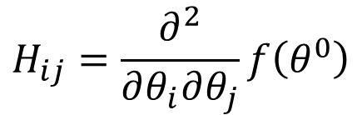

When Gradient is Zero
$f\left(θ\right)=f\left(θ^{0}\right)+{\left(θ−θ^{0}\right)}^{T}g+\frac{1}{2}$ ${\left(θ−θ^{0}\right)}^{T}H\left(θ−θ^{0}\right)+…$
Gradient g is a vector
$$g_{i}=\frac{∂f\left(θ^{0}\right)}{∂θ_{i}}$$
$$∇f\left(θ^{0}\right)$$
Hessian H is a matrix
$$H_{ij}=\frac{∂^{2}}{∂θ_{i}∂θ_{j}}f\left(θ^{0}\right)$$
symmetric
$$=\frac{∂^{2}}{∂θ_{j}∂θ_{i}}f\left(θ^{0}\right)$$
$${=H}_{ji}$$
Notes:
if the second derivatives of f are all continuous
海森矩陣的混合偏導數是海森矩陣非主對角線上的元素。假如他們是連續的，那麼求導順序沒有區別，即

Slide 10
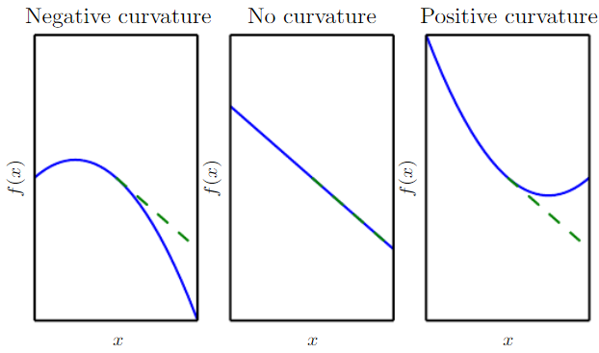
Hessian
Source of image: http://www.deeplearningbook.org/contents/numerical.html
$f\left(θ\right)=f\left(θ^{0}\right)+{\left(θ−θ^{0}\right)}^{T}g+\frac{1}{2}$ ${\left(θ−θ^{0}\right)}^{T}H\left(θ−θ^{0}\right)+…$
H determines the curvature
Notes:
curvature 中文 =
曲率

Slide 11
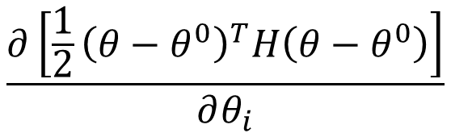


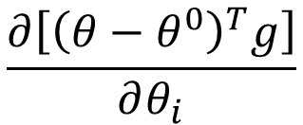

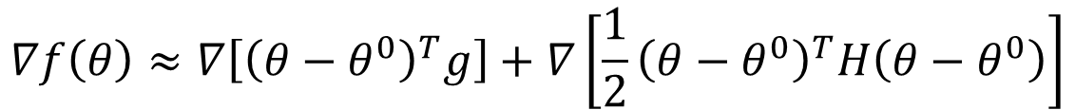

Hessian
$f\left(θ\right)=f\left(θ^{0}\right)+{\left(θ−θ^{0}\right)}^{T}g+\frac{1}{2}$ ${\left(θ−θ^{0}\right)}^{T}H\left(θ−θ^{0}\right)+…$
Newton’s method
Find the space such that
$$∇f\left(θ\right)=0$$
$$∇f\left(θ\right)≈∇\left[{\left(θ−θ^{0}\right)}^{T}g\right]+∇\left[\frac{1}{2}{\left(θ−θ^{0}\right)}^{T}H\left(θ−θ^{0}\right)\right]$$
$$=g$$
$$H\left(θ−θ^{0}\right)$$
$$\frac{∂\left[{\left(θ−θ^{0}\right)}^{T}g\right]}{∂θ_{i}}$$
$$=g_{i}$$
$$\frac{∂\left[\frac{1}{2}{\left(θ−θ^{0}\right)}^{T}H\left(θ−θ^{0}\right)\right]}{∂θ_{i}}$$
Notes:
???

Slide 12
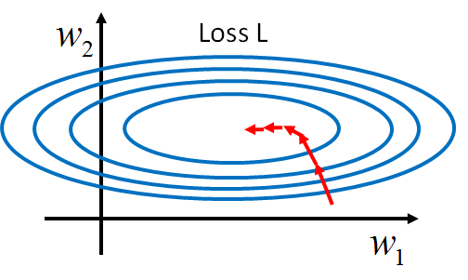






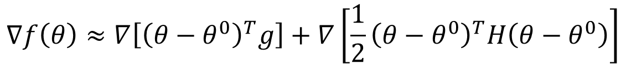


Hessian
$f\left(θ\right)=f\left(θ^{0}\right)+{\left(θ−θ^{0}\right)}^{T}g+\frac{1}{2}$ ${\left(θ−θ^{0}\right)}^{T}H\left(θ−θ^{0}\right)+…$
Newton’s method
$$∇f\left(θ\right)≈∇\left[{\left(θ−θ^{0}\right)}^{T}g\right]+∇\left[\frac{1}{2}{\left(θ−θ^{0}\right)}^{T}H\left(θ−θ^{0}\right)\right]$$
$$=g$$
$$H\left(θ−θ^{0}\right)$$
$$∇f\left(θ\right)≈g+H\left(θ−θ^{0}\right)$$
$$=0$$
$$H\left(θ−θ^{0}\right)=−g$$
$$θ=θ^{0}−H^{−1}g$$
v.s.
$$θ=θ^{0}−ηg$$
$$θ−θ^{0}=−H^{−1}g$$
Change the direction, determine step size
Notes:
If the Hessian is close to a non-invertible matrix, the inverted Hessian can be numerically unstable and the solution may diverge.

Slide 13
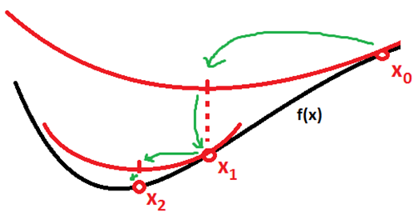
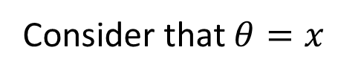
Hessian
Source of image: https://math.stackexchange.com/questions/609680/newtons-method-intuition
$f\left(θ\right)=f\left(θ^{0}\right)+{\left(θ−θ^{0}\right)}^{T}g+\frac{1}{2}$ ${\left(θ−θ^{0}\right)}^{T}H\left(θ−θ^{0}\right)+…$
Newton’s method
Not suitable for Deep Learning
Consider that $θ=x$
?
If $f\left(x\right)$ is a quadratic function, obtain critical point in one step.
What is the problem?

Slide 14
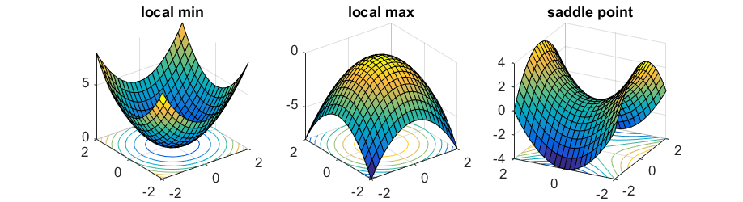

Hessian
Source of image: http://www.offconvex.org/2016/03/22/saddlepoints/
$f\left(θ\right)=f\left(θ^{0}\right)+{\left(θ−θ^{0}\right)}^{T}g+\frac{1}{2}$ ${\left(θ−θ^{0}\right)}^{T}H\left(θ−θ^{0}\right)+…$
At critical point ($g=0$)
H tells us the properties of critical points.

Slide 15
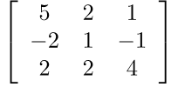

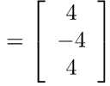
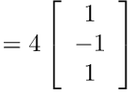

Review: Linear Algebra
http://speech.ee.ntu.edu.tw/~tlkagk/courses/LA_2016/Lecture/eigen.pdf
If $Av=λv$ ($v$ is a vector, $λ$ is a scalar)
  $v$ is an eigenvector of A
  $λ$ is an eigenvalue of A that corresponds to $v$
excluding zero vector
A must be square
Eigen value
Eigen vector

Slide 16






Review: Positive/Negative Definite
An nxn matrix A is symmetric.
For every non-zero vector x ($x≠0$)
$$\left[\begin{matrix}1 & 0 \\ 0 & 1\end{matrix}\right]$$
All eigen values are positive.
positive definite:
$$x^{T}Ax>0$$
All eigen values are non-negative.
positive semi-definite:
$$x^{T}Ax≥0$$
All eigen values are negative.
negative definite:
$$x^{T}Ax<0$$
All eigen values are non-positive.
negative semi-definite:
$$x^{T}Ax≤0$$

Slide 17




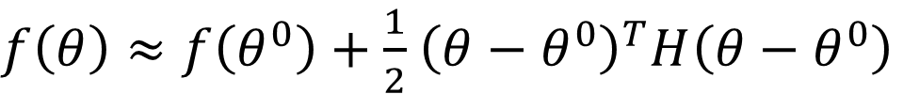






Hessian
$$x^{T}Hx$$
At critical point:
$f\left(θ\right)≈f\left(θ^{0}\right)+\frac{1}{2}$ ${\left(θ−θ^{0}\right)}^{T}H\left(θ−θ^{0}\right)$
H is positive definite
$$x^{T}Hx>0$$
$$x^{T}Hx≥0?$$
All eigen values are positive.
Around $θ^{0}$:
Local minima
$$f\left(θ\right)>f\left(θ^{0}\right)$$
H is negative definite
$$x^{T}Hx<0$$
$$x^{T}Hx≤0?$$
All eigen values are negative
Around $θ^{0}$:
Local maxima
$$f\left(θ\right)<f\left(θ^{0}\right)$$
Sometimes$x^{T}Hx>0$, sometimes$x^{T}Hx<0$
Saddle point

Slide 18

















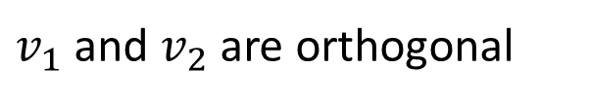
Hessian
At critical point:
$f\left(θ\right)≈f\left(θ^{0}\right)+\frac{1}{2}$ ${\left(θ−θ^{0}\right)}^{T}H\left(θ−θ^{0}\right)$
$v$ is an eigen vector
$$v^{T}Hv$$
$$=v^{T}\left(λv\right)$$
$$={λ\left\|v\right\|}^{2}$$
Unit vector
$$=λ$$
(Ignore 1/2 for simplicity)
$$x$$
$$x={a_{1}v}_{1}+{a_{2}v}_{2}$$
$$+λ$$
$$+λ_{1}$$
$$+λ_{2}$$
$$x^{T}Hx$$
$$v$$
$$v_{1}$$
$$v_{2}$$
$$={\left({a_{1}v}_{1}+{a_{2}v}_{2}\right)}^{T}H\left({a_{1}v}_{1}+{a_{2}v}_{2}\right)$$
$v_{1}$ and $v_{2}$ are orthogonal
$$θ^{0}$$
$$θ^{0}$$
$$={{\left(a_{1}\right)}_{}^{2}λ}_{1}+{\left(a_{x}\right)}_{}^{2}λ_{2}?$$
Because H is an nxn symmetric matrix,
H can have eigen vectors $\left\{v_{1},v_{2}, …, v_{n}\right\}$ form a orthonormal basis.

Slide 19





Hessian
At critical point:
$f\left(θ\right)≈f\left(θ^{0}\right)+\frac{1}{2}$ ${\left(θ−θ^{0}\right)}^{T}H\left(θ−θ^{0}\right)$
$v$ is an eigen vector
$$v^{T}Hv$$
$$=v^{T}\left(λv\right)$$
$$={λ\left\|v\right\|}^{2}$$
Unit vector
$$=λ$$
$$+?$$
$u={a_{1}v}_{1}+{a_{2}v}_{2}+…+$ ${a_{n}v}_{n}$
$$u$$
${{\left(a_{1}\right)}_{}^{2}λ}_{1}+{{\left(a_{2}\right)}_{}^{2}λ}_{2}+…+$ ${{\left(a_{n}\right)}_{}^{2}λ}_{n}$
$$θ^{0}$$
Because H is an nxn symmetric matrix,
H can have eigen vectors $\left\{v_{1},v_{2}, …, v_{n}\right\}$ form a orthonormal basis.

Slide 20
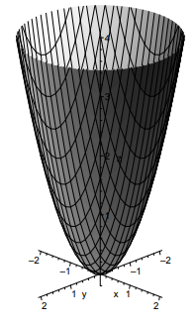













Examples
$$f\left(x,y\right)=x^{2}+3y^{2}$$
$$\frac{∂f\left(x,y\right)}{∂x}=2x$$
$$\frac{∂f\left(x,y\right)}{∂y}=6y$$
$$x=0, y=0$$
$$\frac{∂^{2}}{∂x∂x}f\left(x,y\right)$$
$$\frac{∂^{2}}{∂x∂y}f\left(x,y\right)$$
$$H=\left[\begin{matrix}2 & 0 \\ 0 & 6\end{matrix}\right]$$
$$=2$$
$$=0$$
$$\frac{∂^{2}}{∂y∂x}f\left(x,y\right)$$
$$\frac{∂^{2}}{∂y∂y}f\left(x,y\right)$$
Positive-definite
Local minima
$$=0$$
$$=6$$

Slide 21
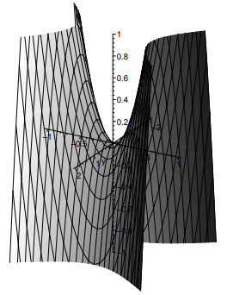





Examples
$$f\left(x,y\right)={−x}^{2}+3y^{2}$$
$$\frac{∂f\left(x,y\right)}{∂x}=−2x$$
$$\frac{∂f\left(x,y\right)}{∂y}=6y$$
$$x=0, y=0$$
$$\frac{∂^{2}}{∂x∂x}f\left(x,y\right)$$
$$\frac{∂^{2}}{∂x∂y}f\left(x,y\right)$$
$$=−2$$
$$=0$$
$$H=\left[\begin{matrix}−2 & 0 \\ 0 & 6\end{matrix}\right]$$
$$\frac{∂^{2}}{∂y∂x}f\left(x,y\right)$$
$$\frac{∂^{2}}{∂y∂y}f\left(x,y\right)$$
Saddle
$$=0$$
$$=6$$

Slide 22













Degenerate
Degenerate Hessian has at least one zero eigen value
$$f\left(x,y\right)=x^{2}+y^{4}$$
$$\frac{∂f\left(x,y\right)}{∂x}=2x$$
$$\frac{∂f\left(x,y\right)}{∂y}=4y^{3}$$
$$x=y=0$$
$$\frac{∂^{2}}{∂x∂x}f\left(x,y\right)$$
$$\frac{∂^{2}}{∂x∂y}f\left(x,y\right)$$
$$H=\left[\begin{matrix}2 & 0 \\ 0 & 0\end{matrix}\right]$$
$$=2$$
$$=0$$
$$\frac{∂^{2}}{∂y∂x}f\left(x,y\right)$$
$$\frac{∂^{2}}{∂y∂y}f\left(x,y\right)$$
$$=0$$
$$=12y^{2}$$
Notes:
If the gradient (the vector of the partial derivatives) of a function f is zero at some point x, then f has a critical point (or stationary point) at x. The determinant of the Hessian at x is then called the discriminant. If this determinant is zero then x is called a degenerate critical pointof f, or a non-Morse critical point of f. Otherwise it is non-degenerate, and called a Morse critical point of f.

Slide 23








Degenerate
Degenerate Hessian has at least one zero eigen value
$$f\left(x,y\right)=x^{2}+y^{4}$$
$$g\left(x,y\right)=x^{2}−y^{4}$$
$$x=y=0$$
$$x=y=0$$
$$g=\left[\begin{matrix}0 \\ 0\end{matrix}\right]$$
$$g=\left[\begin{matrix}0 \\ 0\end{matrix}\right]$$
$$H=\left[\begin{matrix}2 & 0 \\ 0 & 0\end{matrix}\right]$$
$$H=\left[\begin{matrix}2 & 0 \\ 0 & 0\end{matrix}\right]$$
No Difference

Slide 24

















Degenerate
$$h\left(x,y\right)=0$$
$$x=y=0$$
$$g=\left[\begin{matrix}0 \\ 0\end{matrix}\right]$$
$$f\left(x,y\right)=−x^{4}−y^{4}$$
$$H=\left[\begin{matrix}0 & 0 \\ 0 & 0\end{matrix}\right]$$
$$\frac{∂f\left(x,y\right)}{∂x}=−4x^{3}$$
$$\frac{∂f\left(x,y\right)}{∂y}=−4y^{3}$$
$$\frac{∂^{2}}{∂x∂x}f\left(x,y\right)$$
$$\frac{∂^{2}}{∂x∂y}f\left(x,y\right)$$
$$=−12x^{2}$$
$$=0$$
$$\frac{∂^{2}}{∂y∂x}f\left(x,y\right)$$
$$\frac{∂^{2}}{∂y∂y}f\left(x,y\right)$$
$$H=\left[\begin{matrix}0 & 0 \\ 0 & 0\end{matrix}\right]$$
$$=0$$
$$=−12y^{2}$$

Slide 25













Degenerate
http://homepages.math.uic.edu/~julius/monkeysaddle.html
c.f.
Monkey Saddle
$$\frac{∂f\left(x,y\right)}{∂x}=3x^{2}−3y^{2}$$
$$f\left(x,y\right)=x^{3}−3xy^{2}$$
$$\frac{∂f\left(x,y\right)}{∂y}=−6xy$$
$$\frac{∂^{2}}{∂x∂x}f\left(x,y\right)$$
$$\frac{∂^{2}}{∂x∂y}f\left(x,y\right)$$
$$=6x$$
$$=−6y$$
$$\frac{∂^{2}}{∂y∂x}f\left(x,y\right)$$
$$\frac{∂^{2}}{∂y∂y}f\left(x,y\right)$$
$$=−6x$$
$$=−6y$$

Slide 26


Training stuck $≠$ Zero Gradient
http://www.deeplearningbook.org/contents/optimization.html
People believe training stuck because the parameters are around a critical point
!!!
Notes:
Optimization neural network is an non-convex optimization problem ……
Why?

Slide 27

Training stuck $≠$ Zero Gradient
Approach a saddle point, and then escape
http://videolectures.net/deeplearning2015_bengio_theoretical_motivations/

Slide 28
Deep Linear Network

Slide 29







$$w_{1}$$
$$w_{2}$$
$$x$$
$$y$$
$$\hat{y}$$
$$=1$$
$$=1$$
https://arxiv.org/abs/1412.6544

Slide 30















$$w_{1}$$
$$w_{2}$$
$$x$$
$$y$$
$$\hat{y}$$
$$=1$$
$$=1$$
$$L={\left(\hat{y}−w_{1}w_{2}x\right)}^{2}$$
$$={\left(1−w_{1}w_{2}\right)}^{2}$$
$$\frac{∂L}{∂w_{1}}=2\left(1−w_{1}w_{2}\right)\left(−w_{2}\right)$$
The probability of stuck as saddle point is almost zero.
$$\frac{∂L}{∂w_{2}}=2\left(1−w_{1}w_{2}\right)\left(−w_{1}\right)$$
Easy to escape
$$\frac{∂^{2}L}{∂{w_{1}}^{2}}=2\left(−w_{2}\right)\left(−w_{2}\right)$$
$$\frac{∂^{2}L}{∂w_{1}∂w_{2}}=−2+4w_{1}w_{2}$$
$$\frac{∂^{2}L}{∂w_{2}∂w_{1}}=−2+4w_{1}w_{2}$$
$$\frac{∂^{2}L}{∂{w_{2}}^{2}}=2\left(−w_{1}\right)\left(−w_{1}\right)$$

Slide 31

















2-hidden layers
$$w_{1}$$
$$w_{2}$$
$$w_{3}$$
$$x$$
$$y$$
$$\hat{y}$$
$$L={\left(1−w_{1}w_{2}w_{3}\right)}^{2}$$
$$w_{1}w_{2}w_{3}=1$$
global minima
$$\frac{∂L}{∂w_{1}}=2\left(1−w_{1}w_{2}w_{3}\right)\left(−w_{2}w_{3}\right)$$
$$w_{1}=w_{2}=w_{3}=0$$
$$\frac{∂L}{∂w_{2}}=2\left(1−w_{1}w_{2}w_{3}\right)\left(−w_{1}w_{3}\right)$$
$$H=\left[\begin{matrix}0 & 0 & 0 \\ 0 & 0 & 0 \\ 0 & 0 & 0\end{matrix}\right]$$
$$\frac{∂L}{∂w_{3}}=2\left(1−w_{1}w_{2}w_{3}\right)\left(−w_{1}w_{2}\right)$$
So flat
$$\frac{∂^{2}L}{∂{w_{1}}^{2}}=2{\left(−w_{2}w_{3}\right)}^{2}$$
$$w_{1}=w_{2}=0,w_{3}=k$$
$$\frac{∂^{2}L}{∂w_{2}∂w_{1}}=−2w_{3}+4w_{1}w_{2}{\left(w_{3}\right)}^{2}$$
$$H=\left[\begin{matrix}0 & −2 & 0 \\ −2 & 0 & 0 \\ 0 & 0 & 0\end{matrix}\right]$$
All minima are global, some critical points are “bad”.
Saddle point

Slide 32


10 hidden layers
$$θ^{1}$$
origin
$$θ^{2}$$
10-hidden layers

Slide 33
Demo

Slide 34




Deep Linear Network
$$\hat{y}$$
y
W^{K}
W²
W¹
x
…..
$$L=\sum_{n=1}^{N}{{\left(x^{n}−{\hat{y}}^{n}\right)}^{2}}$$
$$y=W_{}^{K}W_{}^{K−1}⋯W_{}^{2}W_{}^{1}x$$
Hidden layer size $≥$ Input dim, output dim
More than two hidden layers can produce saddle point without negative eigenvalues.
Notes:
PCA as an example of linear

Slide 35
Reference
Kenji Kawaguchi, Deep Learning without Poor Local Minima, NIPS, 2016
Haihao Lu, Kenji Kawaguchi, Depth Creates No Bad Local Minima, arXiv, 2017
Thomas Laurent, James von Brecht, Deep linear neural networks with arbitrary loss: All local minima are global, arXiv, 2017
Maher Nouiehed, Meisam Razaviyayn, Learning Deep Models: Critical Points and Local Openness, arXiv, 2018
Notes:
PCA as an example of linear
The paper nicely unifies previous results and develops the property of local openness. While interesting, I find the application to multi-layer linear networks extremely limiting. There appears to be a sub-field in theory now focusing on solely multi-layer linear networks which is meaningless in practice. I can appreciate that this could give rise to useful proof techniques and hence, I am recommending it to the workshop track with the hope that it can foster more discussions and help researchers move away from studying multi-layer linear networks.

Slide 36
Non-linear Deep Network
Does it have local minima?
證明事情不存在很難，證明事情存在相對容易
感謝曾子家同學發現投影片上的錯字

Slide 37


Even Simple Task can be Difficult

Slide 38






ReLU has local
$$x$$
+
+
$$y$$
1
1
1
1
$$x$$
+
+
$$y$$
-3
0
1
1
-7
1
$$x$$
+
+
$$y$$
-4
0
(-1.3) (1,-3) (3,0) (4,1) (5,2)
1
1
This relu network has local minima.

Slide 39
“Blind Spot” of ReLU
0
0
0
0
0
0
0
0
0
Gradient is zero
It is pretty easy to make this happens ……

Slide 40

“Blind Spot” of ReLU
Consider your initialization
MNIST, Adam, 1M updates

Slide 41





















Considering Data
$$w^{1}$$
$${\left(w^{1}\right)}^{T}x$$
n neurons
$$x_{1}$$
+
1
$$w^{2}$$
$${\left(w^{2}\right)}^{T}x$$
1
$$x$$
$$x_{2}$$
+
+
$$y$$
If $n≥k$ and $w^{i}=v^{i}$
……
…
1
$$w^{n}$$
$${\left(w^{n}\right)}^{T}x$$
Network to be trained
+
N(0,1)
We obtain global minima
$$v^{1}$$
$${\left(v^{1}\right)}^{T}x$$
k neurons
$$x_{1}$$
+
1
$$v^{2}$$
$${\left(v^{2}\right)}^{T}x$$
1
The number of k and n matters
$$x$$
$$x_{2}$$
+
+
$$\hat{y}$$
……
…
1
$$v^{n}$$
$${\left(v^{k}\right)}^{T}x$$
Label generator
+

Slide 42

Considering Data
No local for $n≥k+2$

Slide 43
Considering Data

Slide 44
Reference
Grzegorz Swirszcz, Wojciech Marian Czarnecki, Razvan Pascanu, “Local minima in training of neural networks”, arXiv, 2016
Itay Safran, Ohad Shamir, “Spurious Local Minima are Common in Two-Layer ReLU Neural Networks”, arXiv, 2017
Yi Zhou, Yingbin Liang, “Critical Points of Neural Networks: Analytical Forms and Landscape Properties”, arXiv, 2017
Shai Shalev-Shwartz, Ohad Shamir, Shaked Shammah, “Failures of Gradient-Based Deep Learning”, arXiv, 2017
The theory should looks like …
Under some conditions (initialization, data, ……),
We can find global optimal.
Notes:
Understanding Deep Neural Networks with Rectified Linear Units
https://arxiv.org/pdf/1703.07950.pdf
https://medium.com/@Synced/failures-of-deep-learning-61dff4b0b56
https://simons.berkeley.edu/sites/default/files/docs/6455/berkeley2017.pdf
http://icri-ci.technion.ac.il/files/2017/05/13-Ohad-Shamir-170509.pdf

Slide 45
Conjecture about Deep Learning
Almost all local minimum have very similar loss to the global optimum, and hence finding a local minimum is good enough.
Notes:
http://nuit-blanche.blogspot.tw/2018/01/video-and-slides-understanding-and.html
https://www.lpsm.paris//dw/lib/exe/fetch.php?media=users:peche:majumdar1.pdf
Good explaination about random matrix theory
https://davidbarber.github.io/blog/2017/07/30/Optima-in-Feedforward-Neural-Nets/
https://www.kdnuggets.com/2017/06/deep-learning-local-minimum.html more???
Why Deep Learning Works: Perspectives from Theoretical Chemistry https://www.youtube.com/watch?v=kIbKHIPbxiU

Slide 46








Analyzing Hessian
When we meet a critical point, it can be saddle point or local minima.
Analyzing H
If the network has N parameters
$$v_{1}$$
$$v_{2}$$
$$v_{3}$$
……
$$v_{N}$$
$$λ_{1}$$
$$λ_{2}$$
$$λ_{3}$$
……
$$λ_{N}$$
We assume $λ$ has 1/2 (?) to be positive, 1/2 (?) to be negative.

Slide 47






Analyzing Hessian
If N=1:
If N=2:
If N=10:
$$v_{1}$$
1/2 local minima, 1/2 local maxima,
Saddle point is almost impossible
$$λ_{1}$$
+ +
- -
$$v_{1}$$
$$v_{2}$$
1/4 local minima, 1/4 local maxima,
1/2 Saddle points
$$λ_{1}$$
$$λ_{2}$$
+ -, - +
1/1024 local minima, 1/1024 local maxima,
Almost every critical point is saddle point
When a network is very large,
It is almost impossible to meet a local minima.
Saddle point is what you need to worry about.

Slide 48


Error v.s. Eigenvalues
We assume $λ$ has 1/2 (?) to be negative.
p
p is a probability related to error
Larger error, larger p
Source of image: http://proceedings.mlr.press/v70/pennington17a/pennington17a.pdf
Notes:
This probably provide proof
http://proceedings.mlr.press/v70/pennington17a/pennington17a.pdf

Slide 49
Guess about Error Surface
saddle
(good enough)
global minima
local minima
https://stats385.github.io/assets/lectures/Understanding_and_improving_deep_learing_with_random_matrix_theory.pdf

Slide 50
Training Error v.s. Eigenvalues

Slide 51
Training Error v.s. Eigenvalues
Portion of positive eigenvalues
“Degree of Local Minima”
1 - “degree of local minima”
(portion of negative eigen values)

Slide 52

theoretical
empirical
1 - “degree of local minima”
1 - “degree of local minima”
$$α∝{\left(\frac{ε}{c}−1\right)}^{3/2}$$
(portion of negative eigen values)

Slide 53

Spin Glass v.s. Deep Learning
Deep learning is the same as spin glass model with 7 assumptions.
spin glass model
network

Slide 54
More Theory
If the size of network is large enough, we can find global optimal by gradient descent
  Independent to initialization

Slide 55
Reference
Razvan Pascanu, Yann N. Dauphin, Surya Ganguli, Yoshua Bengio, On the saddle point problem for non-convex optimization, arXiv, 2014
Yann Dauphin, Razvan Pascanu, Caglar Gulcehre, Kyunghyun Cho, Surya Ganguli, Yoshua Bengio, “Identifying and attacking the saddle point problem in high-dimensional non-convex optimization”, NIPS, 2014
Anna Choromanska, Mikael Henaff, Michael Mathieu, Gérard Ben Arous, Yann LeCun, “The Loss Surfaces of Multilayer Networks”, PMLR, 2015
Jeffrey Pennington, Yasaman Bahri, “Geometry of Neural Network Loss Surfaces via Random Matrix Theory”, PMLR, 2017
Benjamin D. Haeffele, Rene Vidal, ” Global Optimality in Neural Network Training”, CVPR, 2017

Slide 56
What does the Error Surface look like?
Notes:
An Empirical Analysis of Deep Network Loss Surfaces
https://openreview.net/forum?id=rkuDV6iex

Slide 57




Error Surface
$$L$$
$$w_{1}$$
$$w_{2}$$

Slide 58



Profile
local minima is rare?
$$θ^{0}$$
$$θ^{∗}$$
$$θ^{0}+2\left(θ^{∗}−θ^{0} \right)$$

Slide 59


Profile

Slide 60


Profile
two random starting points
two “solutions”

Slide 61


$$θ^{0}$$
$$θ^{∗}$$

Slide 63
Profile - LSTM

Slide 64

Training Processing
Different initialization / different strategies usually lead to similar loss (there are some exceptions).
6-layer CNN on CIFAR-10
Different initialization

Slide 65
Training Processing
Different strategies (the same initialization)
Notes:
Different solutions

Slide 66

8% disagreement

Slide 67


Training Processing
http://mypaper.pchome.com.tw/ccschoolgeo/post/1311484084
Different training strategies
何時分道揚鑣？
Different basins

Slide 68
Training Processing
Training strategies make difference at all stages of training

Slide 69


Larger basin for Adam

Slide 70

Batch Normalization

Slide 71
Skip Connection
Notes:
Hao Li1 , Zheng Xu1 , Gavin Taylor2 , Christoph Studer3 , Tom Goldstein1 1University of Maryland, College Park, 2United States Naval Academy, 3Cornell University

Slide 72
Reference
Ian J. Goodfellow, Oriol Vinyals, Andrew M. Saxe, “Qualitatively characterizing neural network optimization problems”, ICLR 2015
Daniel Jiwoong Im, Michael Tao, Kristin Branson, “An Empirical Analysis of Deep Network Loss Surfaces”, arXiv 2016
Qianli Liao, Tomaso Poggio, “Theory II: Landscape of the Empirical Risk in Deep Learning”, arXiv 2017
Hao Li, Zheng Xu, Gavin Taylor, Christoph Studer, Tom Goldstein, “Visualizing the Loss Landscape of Neural Nets”, arXiv 2017

Slide 73
Concluding Remarks
Notes:
An Empirical Analysis of Deep Network Loss Surfaces
https://openreview.net/forum?id=rkuDV6iex

Slide 74
Concluding Remarks
We learn Hessian.
Deep linear network is not convex, but all the local minima are global minima.
  There are saddle points that are hard to escape.
Deep network has local minima.
  We need more theory in the future
Conjecture:
  When training a larger network, it is rare to meet local minima.
  All local minima are almost as good as global
We can try to understand the error surface by visualization.

